Slide 1
Search Engines and Online Libraries
Free Software
Patents for Software Inventions
A Gift Of Fire by Sara Base(4.4-4.6)
Presented by: Yuqing Lin

Slide 2
Road Map
Search Engines:
Web pages
Newspapers
Books
Patents for software innovations
Patents vs Copyrights
Issues after 1981
Patent companies
1
3
Free Software:
The Free Software Movement
Linux
Copyleft
Conclusion:
Ethical Analysis
2
4

Slide 3
1
Search Engines and Online Libraries
Notes:
I am sure everyone use at least one search engines like Google Bing etc
Search engines is a hugely variables innovations tools making information easily accessible.
However:
Before we talk about issues relate to search engines, we should know how search engine works.
When search engines get a queries, they can’t just go to the cyberspace and scan everything, that would take days!
So how they response to search queries?

Slide 4

About Search Engines
In response to search queries:
Cache: fetch storing data from website
Copy: entire books, articles and newspapers
Google:
Often sued by individuals.
Provide links to websites that violate copyright
Copies everything (Web text, news, books, images, video)
(“Google's search overhaul: what does it mean for advertisers”,2016)
Notes:
That’s issues, Google as the biggest search engine company comes to be our main target in this chapter.
Google search services has always been sued by individuals since Google copy everting!
That leads to the questions should search engines need authorization for the copying content for better search services?
If so should they pay for it?
As always, uncertainties about the legal status of industry practices can delay innovation

Slide 5
Search Engines Issues
Kelly vs Arriba Soft
Copying and converting images into small, low-resolution copies is legal
Field vs Google
Copying and caching posts on websites is legal.
Notes:
Kelly vs Arriba Soft:
Kelly sue Arriba Soft for copying images from their websites.
Field vs Google:
Field sought $2,550,000 composition in statutory damages ($50,000 for each of the 51 registered copyrighted works) in conjunction with injunctive relief.
A author sue google for copying and caching a story he post on website.
How could that be? Search engines copy stuff for search purpose is legal?

Slide 6
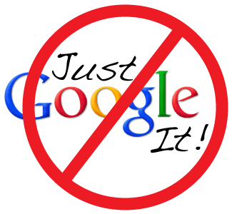
Arguments Against Search Engines
Copying for commercial purposes
Display excerpts may reduce income to authors or copyright holders
Newspapers
(Pivot Cloud Solution 2018)
Notes:
Search engines companies make significant revenue, which means the copying is for commercial propose, vliolting copy right law
Display
People do not click through the news site if they have gathered enough information from the excerpts.

Slide 7
European Laws
Belgian Newspapers
Germany
Spain
Search engines pay service fees to industry organizations
Companies can' t waive the fee.
Lost revenue
Sued Google and won
Search engines should get permission from newspapers for displaying excerpts.
Google: No! I’m out!
Notes:
Google refused to pay such fee to one of German biggest newspaper, sicj as AxeL Springer
Alxel Springer did not allow google to show content of their website, A year later they reverse this policy due to traffic from google significant droped.
Google also refuse pay in Spain end up shut down google news Spain and remove Spanish publishers from other news service
Reported 10to 14% in site vistoer drop. Small news companies shut down.
Both do not have a good outcome, copyright semms shouldn't apply to search engines.
We are no saying this three ways approaching are bad but overall:
Belgian and Germany try to apply copyright to the excerpts, they evaluate increase or decrease traffics to the publish website and charge search engine a fee for display excepts
Spanish just apply the price high enough to kill such service that many businesses would like especially small business.
Copy right seems shouldn't apply on search engines.

Slide 8

Books Online:
The project Gutenberg:
Converting books into digital versions in the 1970s.
Google and Microsoft:
Started their Library Project in the early 2000s.
Microsoft：Scanned books only in the public domain.
Google: Scanned copyrighted books and display excerpts.
All without permission of the copyright holders!
(“Google Book”,2019)
Notes:
While Microsoft only copy books in the public domain
Huge violation to copy right?
Google library project generated many lawsuit. The most important is:
The Authors Guild et al. VS Google

Slide 9
The Authors Guild et al. Vs Google, Inc.(2005-2016)
Judge Denny Chin:Google's Library Project is fair
Increases accessibility of information
Helps researchers and readers find relevant sources
Enables research topics such as analysis of history by language
Preserves old and fragile books
Notes:
Google transformed books into something new and more valuable
Chin also observe that Google dose not sell copies or excerpts online.No ads display on website for book that Google does not have permission to copy.
Although,Google's copping was a huge one and no previous cases, Google Books library no doubt improves sales.
However, what if Judge Chin rule in a different way? How the world would different now?
Copyright is to promote progress

Slide 10
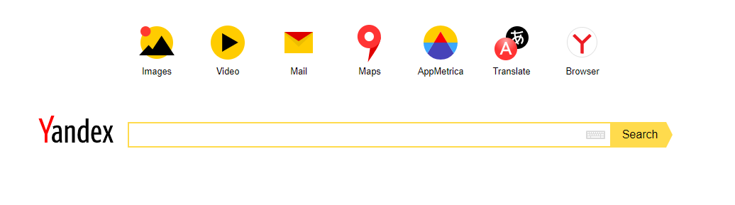

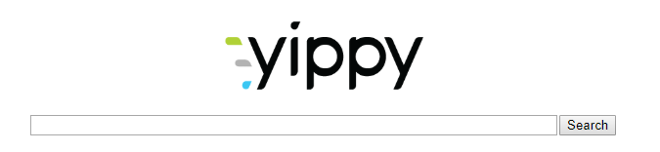
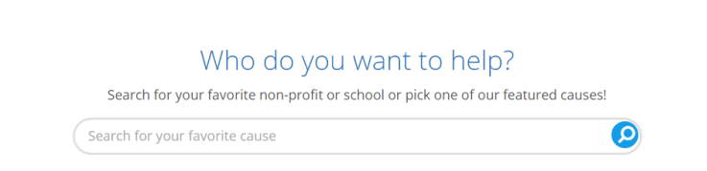

International Outside Source:
Other Search Engines
(Going Beyond Google: A Comprehensive List of Search Engines,2015)
S
Notes:
Spandex is a Russia shearch engines found in 1997, and quickly rising become the country primary search engine.One of the feature Yandex provide is cross langual search. If you looking for bilangua search, this is the best.
Yippy is a search engines for deep web search, different than tranditional search enegines, it provide result as a form of cloud, it's more capabel of deep web search.
DuckDuck Go focus on user's privace, it does not access to your history ,emails social medias.reduced advertising spam by using infinity scoll option(do no need to click next page) prevent ads track and ads spam.
Goodsearch is a search engine for charity, they donate 50%of their revenue from you, to the school or non-profit organization you pick.
Biadu is a chinese google.

Slide 11
2
Copyleft & Free Software
Notes:
We are use gitHub, githut is the biggest open soureplate form on the world, it's predessor is free software movment.

Slide 12
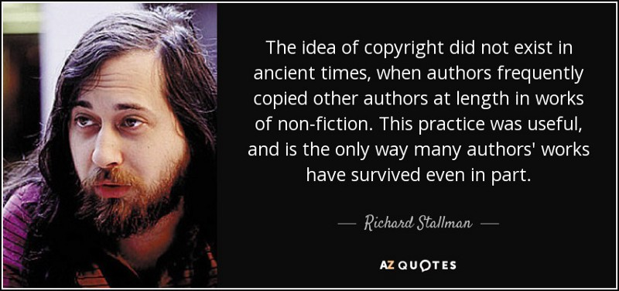
Free Software Movement:
Richard Stallman:
Founder and advocate of Free Software Movement.
Began at 1970s
Created a Unix-like operating system Called GNU
(“The End of Stallman’s Law”,2016)
Notes:
Free software is the idea from a group of loos kneed software professional.
with sophisticated text editor, compilers and utilities.
With his work and whole bunch loose ness computer professional, The free software movement began at 1970
But, thing are not easy at the beginning.

Slide 13

Linux:
Before Linux:
Professional programmers and hobbyists use free software
Commercial software companies are hostile to them
After Linux:
Free software continued development and grew faster
Companies accepted the idea of Free Software
(“Linux”,2019)
Notes:
Only support by some professional programmers, commercial software companies just hate tham.
At first Linux was difficult to use since it’s a kernel the operating system, all gui are done by GNU.
Later on since Linux keep improving , small company began to sell Linux along with user manuals and technical support
Big company like IBM oracle begin to use and support Linux and appreate the benifit of open source.
IBM donate hundreads of patent to free software community.
Free software grew to become a competitor of Microsoft
Major companies came to appreciate open source for it’s convinces. They adapt to the view of free software and publish their software code.
Some company would trust the software if they know how the software is operating.
Some state government encourage offices to switch over Linux from windows avoid license fee.
Then why free software now become so popular?

Slide 14
Free Software:
Advantages
Disadvantages
Fixes bugs quickly
Adapts and improves
Modifies
Creates better versions
Hard for normal consumers to use
Too many modified versions
Lack of standards
Notes:
As millions of programmer out their using Git Hub, supporting free software.
They help fix bugs quickly as well as adapt and improve the software.
They also able to help modify software quickly to meet users requirement
Also create a better version as long as free.
Disadvantages:
It’s hard to use, as we taking cs cours we get clone and push our software, it’s hard for inexperience user to use at the first step.
Since everything is free, everyone could modify and publish their version. There just too many modify versions and lack of standards.
Commercial software company hate them.

Slide 15

Copy Left:
Open source licensing agreement
Protected by legal frameworks
Openness Matters
(“Copyleft”,2019)
Notes:
Under copyleft, developers who copy free program to use, modify, and distribute must apply the same agreement to other users.
Courts uphold copyleft: person who distributes a open source software can sue someone who uses the software for commercial purposes and fails to obtain the agreement.
In anoter word, it's illegal to develop a new program from a copylefted program and restriction to limit the program use and free distribution.

Slide 16
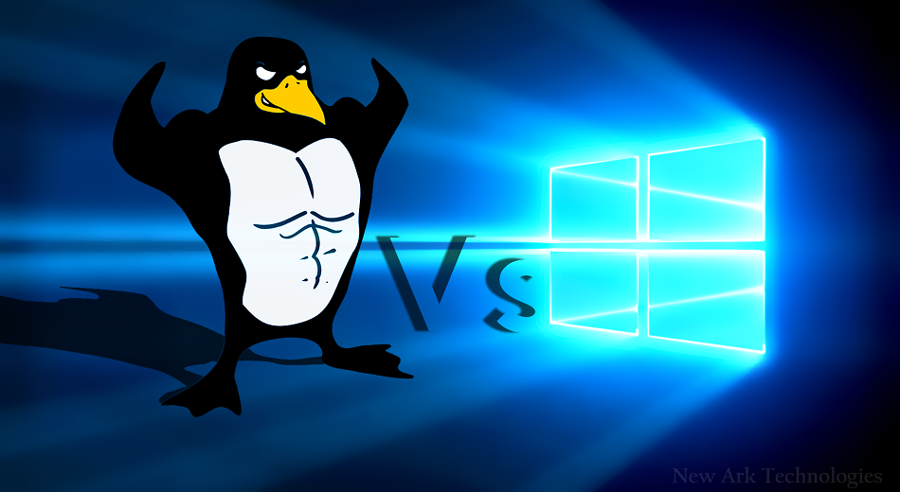
Domestic Outside Source
Linux is much safer than Windows
Hackers are less likely to hack Linux
Permissions are required before executing tasks
Larger professional community of developers
Source: Why Linux is More Secure than Windows. (n.d.). Retrieved March 2, 2019, from https://www.cbtnuggets.com/blog/2018/01/why-linux-is-more-secure-than-windows/ Figue 1. (“Linux solutio”, 2018)
Notes:
On Friday 12th May 2017, the virus ‘WannaCry’ hit the world, affecting over 200,000 machines in more than 150 countries.
Linux only have less then 3% of the market, hackers are less likely to attack Linux than windows since a pieces malware could attack much larger group of users in windows.
Linux require permission all over the place , including download executing change setting. MS gives user a high level access right to the OS while Super user mode lock out the system core from users.
Most important reason:
Although MS have an army of developers , Linux still have more developers work for them. With so many developers monitoring issues from Linux, is like to fix bug before hackers catch them.
This condition could also aply to other free software. Open source software allow we to know what going on inside the program. We can check the program like a peer review article.
And it’s free right? But before you enjoy this free, some requirement we have to follow.

Slide 17
3
Patents for Software Inventions

Slide 18
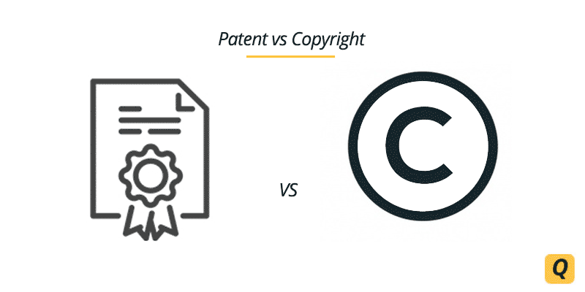
Patent vs Copyright
Copyrights: Protect expressions or implementations.
Patent: Protect inventions and discoveries .
Except: Laws of nature and mathematical formulas.
The U.S Patent and Trademark Office:
Did not issue patents to software until 1981.
(“Difference Between Patent and Copyright”,2019)
Notes:
Anyone who wants to use the patent in their products need to pay license fees and get the authorization from patent holder.
Everyone can register patent in Patent office except Patent officers.However, software is not in the Patent list since it's abstract machine or process include software
However innovation implemented in software change this idea, Supreme court rule software can be patent in 1981 but then problems follow.

Slide 19

Problems after 1981:
Patent office issued so many patents ,exceeding 65000 per year and growing.
Not enough patent attorneys to review patents.
Difficulties for companies
(“United States Patent and Trademark Office”,2019)
Notes:
Patent is now covering computer algorithms, location service for smart phones privacy controls, pop-up ads and much more.
It's very hard to let companies if a new software they are doing contain pigmentation to a patent.
Some example of too many patent uncertainties for Companies:
The most famous one is Apple sue Samsung for infringe serous of patents and won 1 billion.
Since there are too many patents, three different kinds social phenomenal or business mode appear in recent decades.

Slide 20
Patent companies:
Normal Patent Companies:
Collects fees from companies use their patents.
Litigate against those who are violating their patents.
“Patent trolls”:
Buy patents to bring lawsuits to others
Can get large settlements from lawsuits
Generating high legal costs to victims
Threatening and discouraging to innovators-High social cost
Notes:
There are two types of patent company
One: Some companies buy patents license patents for people who use their patents.

Slide 21
“Defense Weapons”:
Large tech companies buy thousands of patents
Sue other companies for patent infringement
Protect continuous innovations
For future software developments
Notes:
Sue other companies for patent infrigment while other suing those compain sue them for patent infrigment
kinda like a trade or balance. So they prevent lost and finding profit deals.
Maintaning an apps like anroid, google brougt Nortel patents to prevent others to sue back google.
Prevent other companies see the future and register the patent which stop an app future developments.
Although the the numbers of software and patents continue grow, congress and courts have puted effort to control, slow and revese pattent.

Slide 22
Reactions by Congress and Courts
Supreme court ruling in 2007(SR VS Teleflex)
Declares the standar for rejecting patents
Invents Act of 2011
Earse patents now becomes easier
2014 decision
Supre cout rejects more patents than before
Notes:
Although the the numbers of software and patents continue grow, congress and courts have puted effort to control, slow and revese pattent.
The supreme court ruling in 2007 declare the standar for rejecting patents
Under the Amerca invents Act of 2011, patent office adopted new rules so it's eariler for them to erase and perior granted patents.
2014 decision that Supreme court ruled against cetain software paten in a case which led to the supre cour reject more patent now.
People are also worry about the 2014 dcisionm,which make erase patent so eaisers add uncertainty for inventor and affect decision about inverting in invention.

Slide 23
Ethical Analysis:
Utilitarianism(Mill)
All software should be free
Programmers should work for low pay out
Share all software for the greater good
Notes:
Stallman believes:
Copyright on software is unethical
Copy Program is fair to both user and programmer
Copyright is to promote progress in arts and sciences but not for computer software
Good programmers should work like artists for low pay out.
postive right:
you have the right to distribute your software as interste.
Or distribute your software as commercial software and make profits on it.
Negative right:
Your program is protive by copy left and open source lincesing agreement.
They help you to maintance the purpose of create this program
Negative right which is copyleft and opensource licening aggrement to help keep the opennesses.

Slide 24
Conclusion:
Laws maintain and help technologies move forward
Differences between free, open source software, and patented software
Keep the balance betwen patented software and free software

Slide 25
References:
Copyleft. (2019, February 26). Retrieved February 27, 2019, from https://en.wikipedia.org/wiki/Copylef
Dent, A. (n.d.). Google's search overhaul: What does it mean for advertisers? Retrieved March 2, 2019, from https://www.campaignlive.co.uk/article/googles-search-overhaul-does-mean-advertisers/1384575
Free VPN vs Paid VPN- What's the difference? - Compsmag. (2015, September 18). Retrieved February 28, 2019, from https://www.compsmag.com/free-vpn-vs-paid-vpn
Gadaleta, F., & Gadaleta, F. (2016, November 28). The End of Stallman's Law – Data Science at Home – Medium. Retrieved February 27, 2019, from https://medium.com/data-science-at-home/the-end-of-stallmans-law-f0ad741c88f0
Google Books. (n.d.). Retrieved from https://books.google.com/
Kesler, A. (2018, September 19). A Comprehensive List of Search Engines | SEJ. Retrieved March 3, 2019, from https://www.searchenginejournal.com/going-beyond-google-comprehensive-list-search-engines/123880/#close
Linux Vs Windows Web Hosting Servers. (n.d.). Retrieved March 2, 2019, from https://www.shorelinuxsolutions.com/linux-vs-windows-web-hosting
No Google, how we did it (So can you, if you want). (n.d.). Retrieved March 1, 2019, from https://pivotcloudsolutions.com/blog/?p=168
Too Many Patents. (n.d.). Retrieved March 1, 2019, from https://www.patentprogress.org/systemic-problems/too-many-patents/
United States Patent and Trademark Office. (2019, January 30). Retrieved March 2, 2019, from https://en.wikipedia.org/wiki/United_States_Patent_and_Trademark_Office
Why Linux is More Secure than Windows. (n.d.). Retrieved March 2, 2019, from https://www.cbtnuggets.com/blog/2018/01/why-linux-is-more-secure-than-windows/

Slide 26
Question 1:
Which of the following events happend during the 1970s
A: KSR VS Teleflex
B: Linux first release
C: Google's Library Project
D: Patent office issued the first patent to a software
E: None of above

Slide 27
Which of the following events happened during the 1970s
A: KSR VS Teleflex (2007)
B: Linux first release (1991)
C: Google's Library Project (2000s)
D: Patent office issued the first patent to a software(1981)
E: None of above
Both the free software movement and the project Gutenberg happened in 1970s.

Slide 28
Question 2:
Which of the following options is not a reason to explain why large companies buy patents as “Weapons”
A: Protect continuous innovations
B: For future software developments
C: For profit
D: To sue other companies for patent infringement when those companies sue them

Slide 29
Which of the following options is not a primary reason explains why large companies buy patents as “Weapon”
A: Protect continue innovations
B: For future software developments
C: For profits
D: Sue other companies for patent infringement when those companies sue them.
Large tech companies spend significant amount of money on patents every year mainly for “Defense”. Only patent companies buy and keep patents for profits.

Slide 30
Question 3:
Why does Google's Library Project not infringe on copyright law?
A:Increases access to information
B:Helps researchers and readers find relevant sources.
C:Enables research topic like analyzing history by language
D:Preserves old and fragile books
E:All of above

Slide 31
Why Google's Library Project did not infringe on copy right law?
A:Increases access to information
B:Helps researchers and readers find relevant sources.
C:Enable research topic like analyze history by language
D:Preserve old and fragile books
E:All of above
Google also prevent users create a entire book base on excepts provided by google.
Google do not advertise on web pages about books it did not have permission to copy.

Slide 32
Thank You

